Slide 1
FuelMart & Subway Safety Committee Meeting
Wednesday, July 17, 2019
2:00 PM
Corporate Office Conference Room and GoTo Meeting Web Conference

Slide 2
1. Safety Topic – Fatigue 2. No open floor items last month.
June 2019 Review:

Slide 3
Operation Safe Driver Week Sun., July 14 through Sat. July 20, 2019
According to National Highway Traffic Safety Administration (NHTSA) data, in 2017, speeding was a contributing factor in 26 percent of all traffic fatalities.
Comprised of all law enforcement jurisdictions (local police, county sheriffs, state highway patrol, and DOT officers). The initiative focuses on both passenger vehicles and CMVs.
Looking for:
Speeding Distracted Driving Texting Following too close
Reckless or aggressive driving Failure to obey traffic control devices
No seatbelt usage Other dangerous driving behaviors

Slide 4
Incidents and Injuries From 06/18/2019 to 07/15/2019

Slide 5
Employee Injuries:
Previous Injury - 04/15/2019 - Last reported FM & Subway employee work-related injury. Employee bumped tomato slicing blade and cut left ring finger. First aid treatment only.
Corrective Action – Employee should have been wearing cut resistant gloves. Employee was re-trained.
06/24/2019 – Subway employee putting bread on a rack and burnt arm on pan.
Note: 3rd burn injury in 2019 from Subway bread pans.

Slide 6
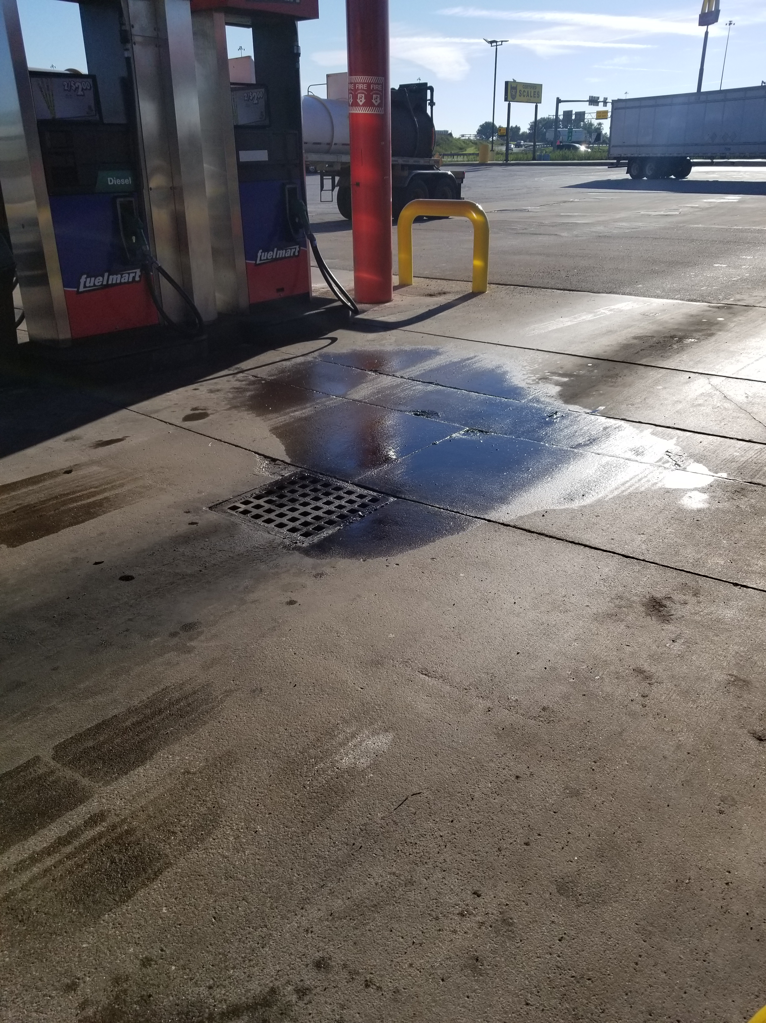
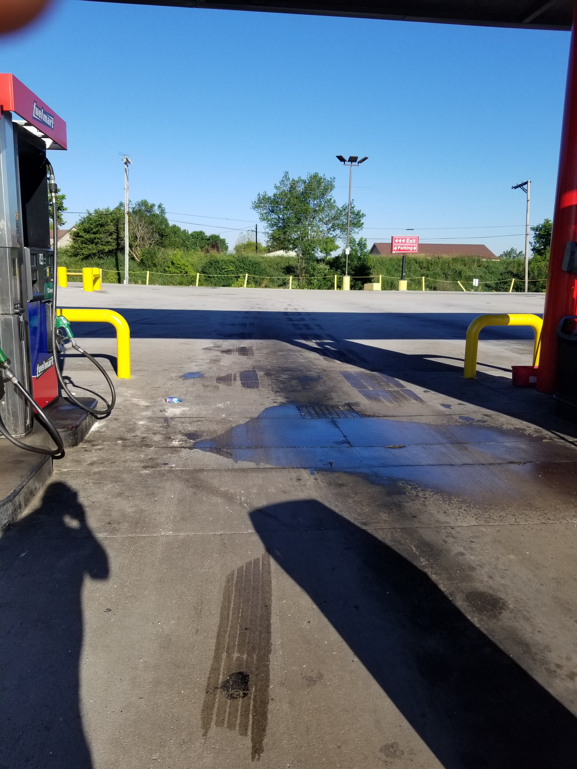
FM 641 Diesel Spill:
On 06/21/2019 a fuel nozzle on satellite pump 14 did not shut off resulting in a minor diesel spill which was contained to the diesel island and oil water separator. Customer reported the incident.

Slide 7
FM 783 Customer to Customer vehicle incident:
On 06/24/2019 a customer vehicle made contact with another customer vehicle. No injuries and no FM property damage. Local police dept. responded. A trailer struck a car damaging the passenger side rear of the vehicle. No photos.

Slide 8
FM 767 Customer Incident:
On 06/27/2019 a customer fell getting out of his truck. The customer was older with personal medical issues. Ambulance was called. Customer refused treatment. FM took photos of the vehicle and area.

Slide 9
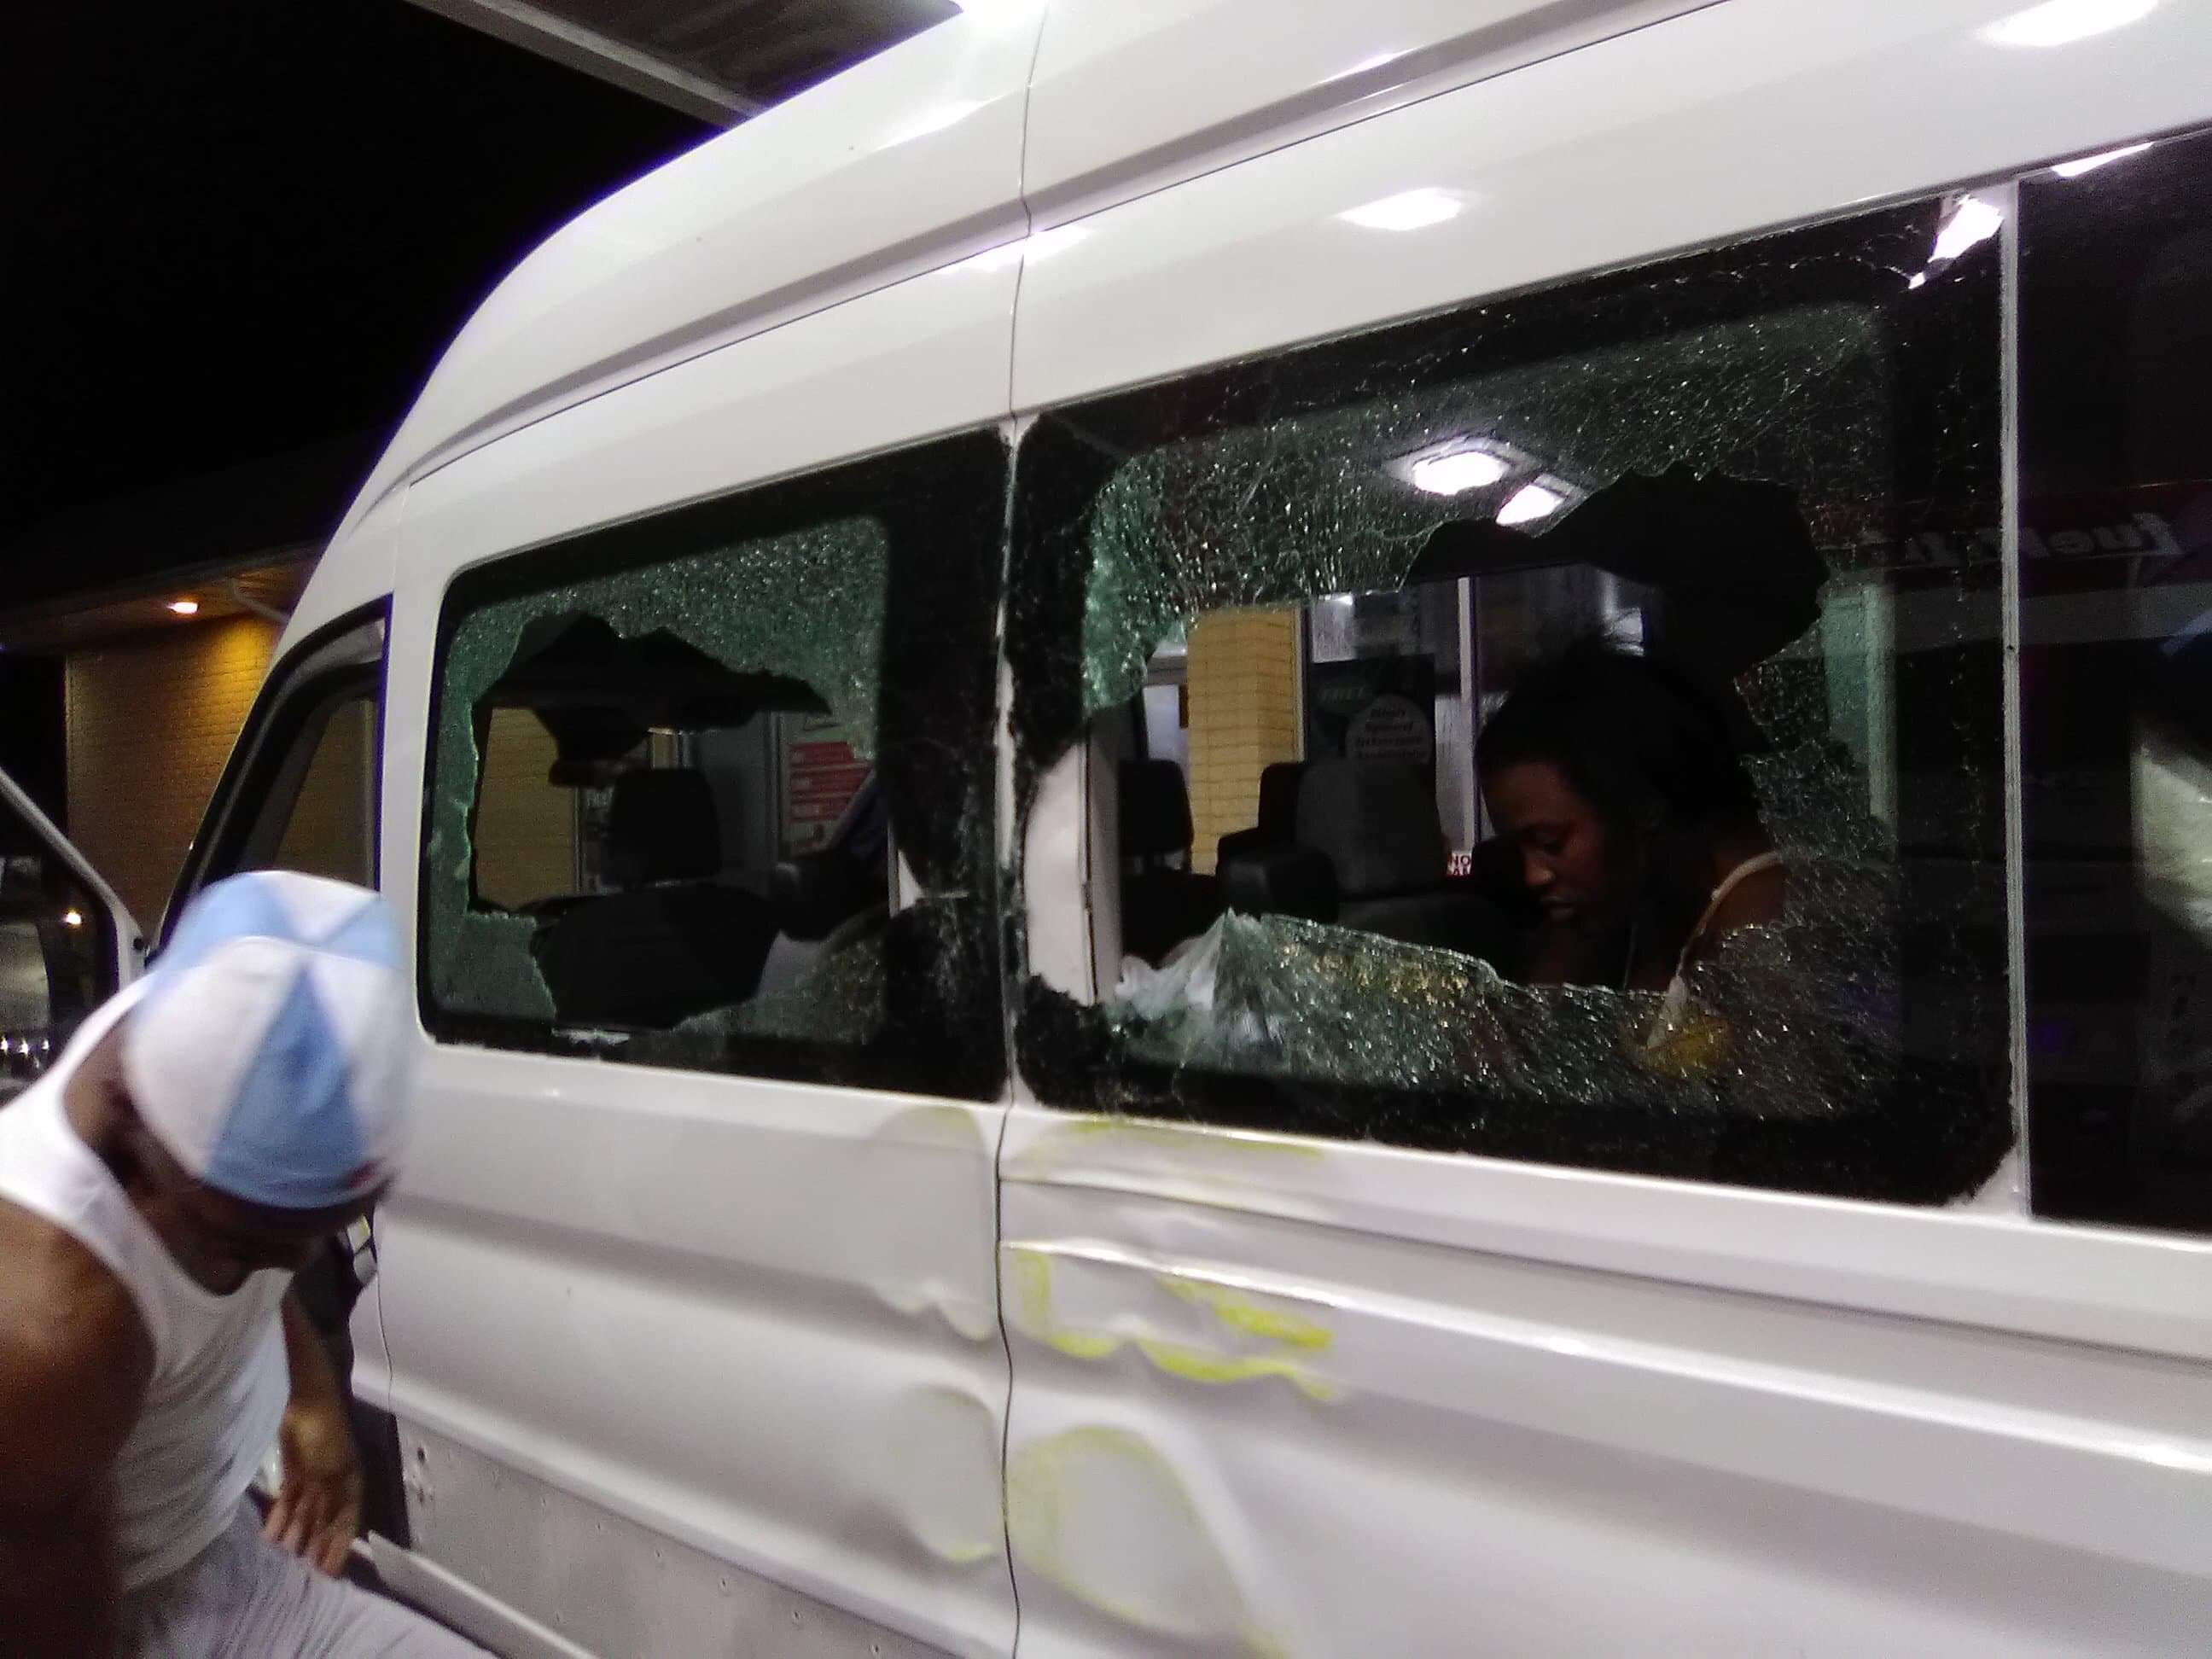
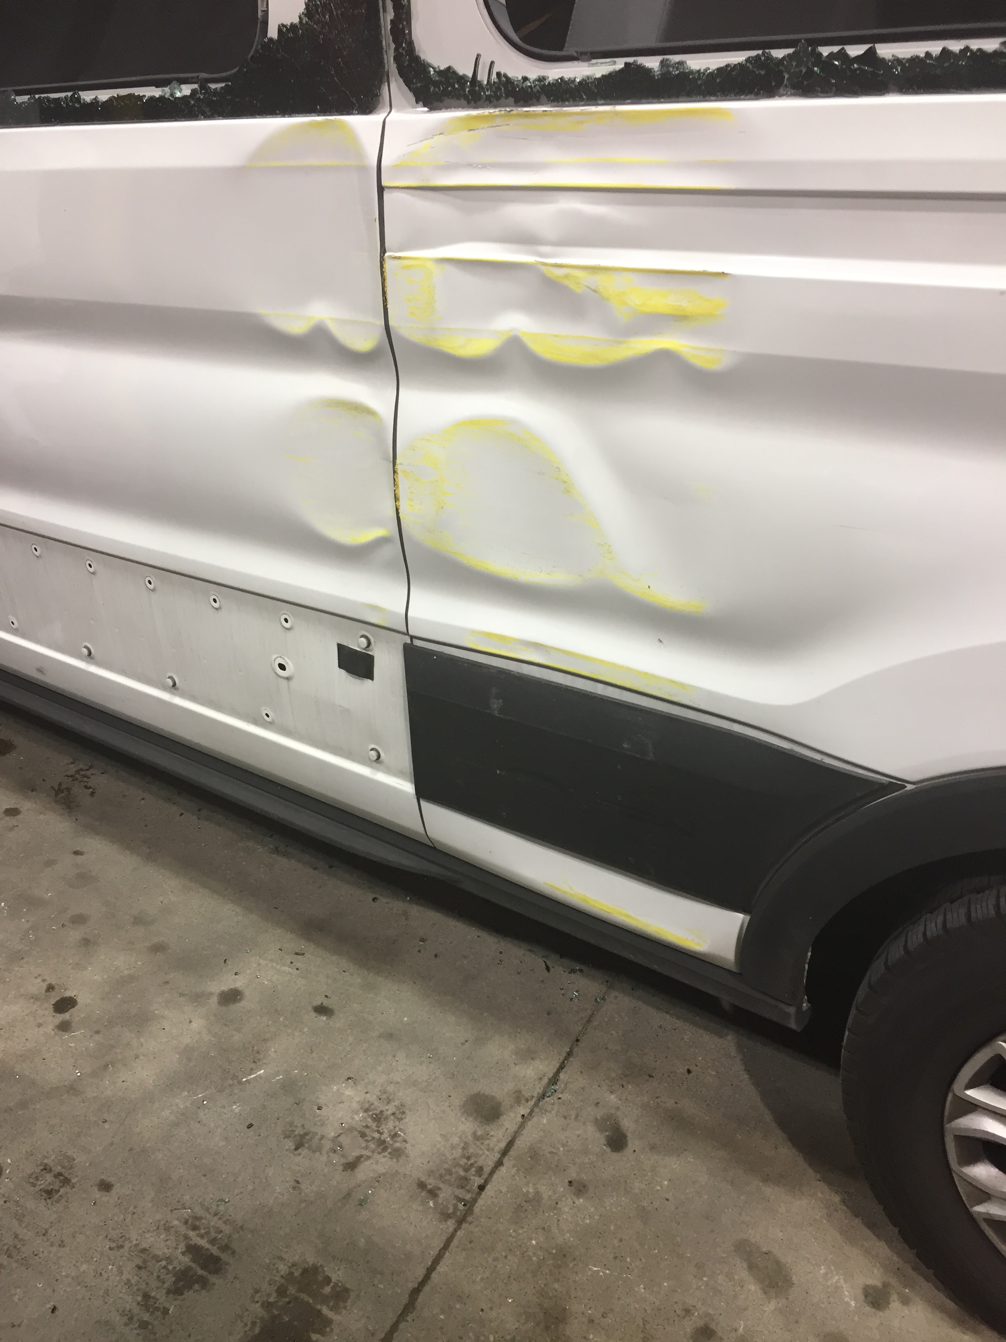
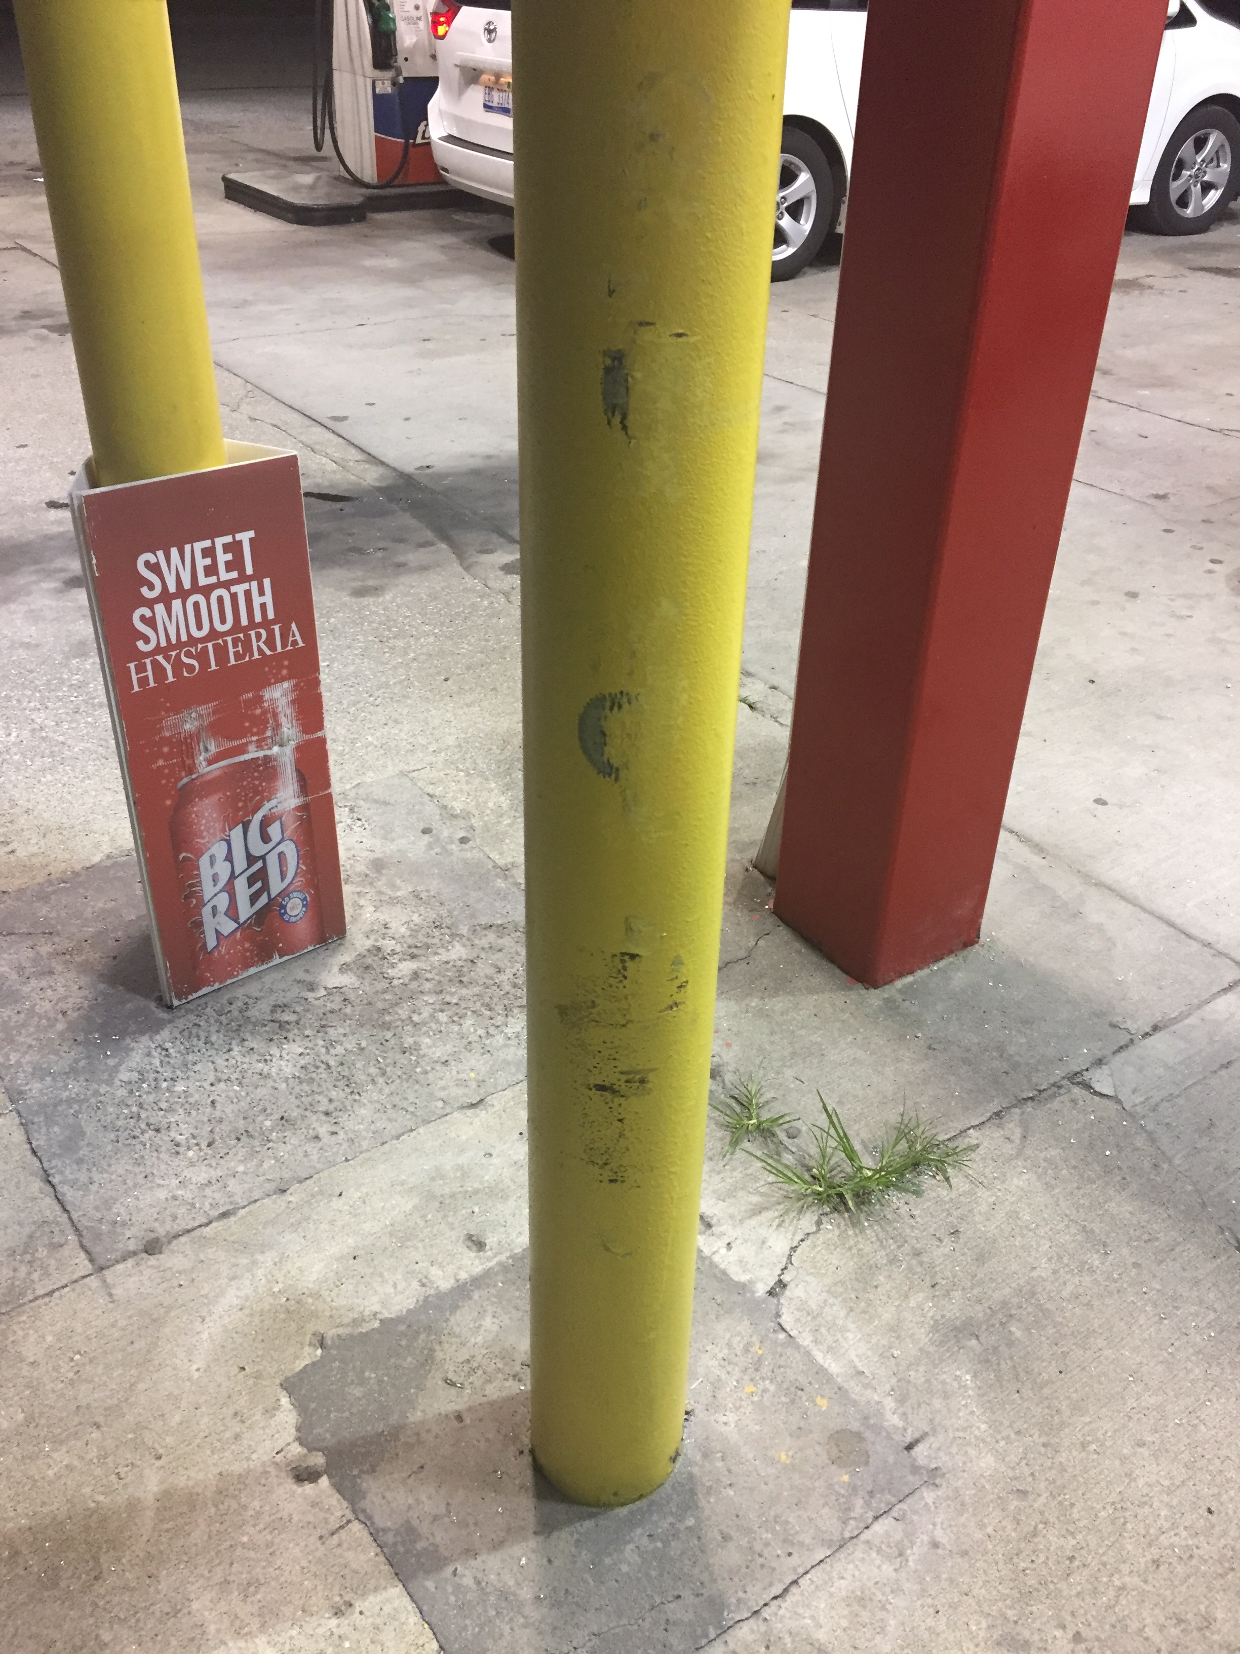
FM 783 FM Property Damage:
On 06/27/2019 a customer (1) was driving to the pump when another customer (2) started backing up quickly and to avoid being struck. Customer 1 turned and struck the yellow pump bollard causing damage to the vehicle including broken window. Glass on ground. NO FM property other than paint scraps. Customer could not produce vehicle insurance. Police Dept. responded.

Slide 10
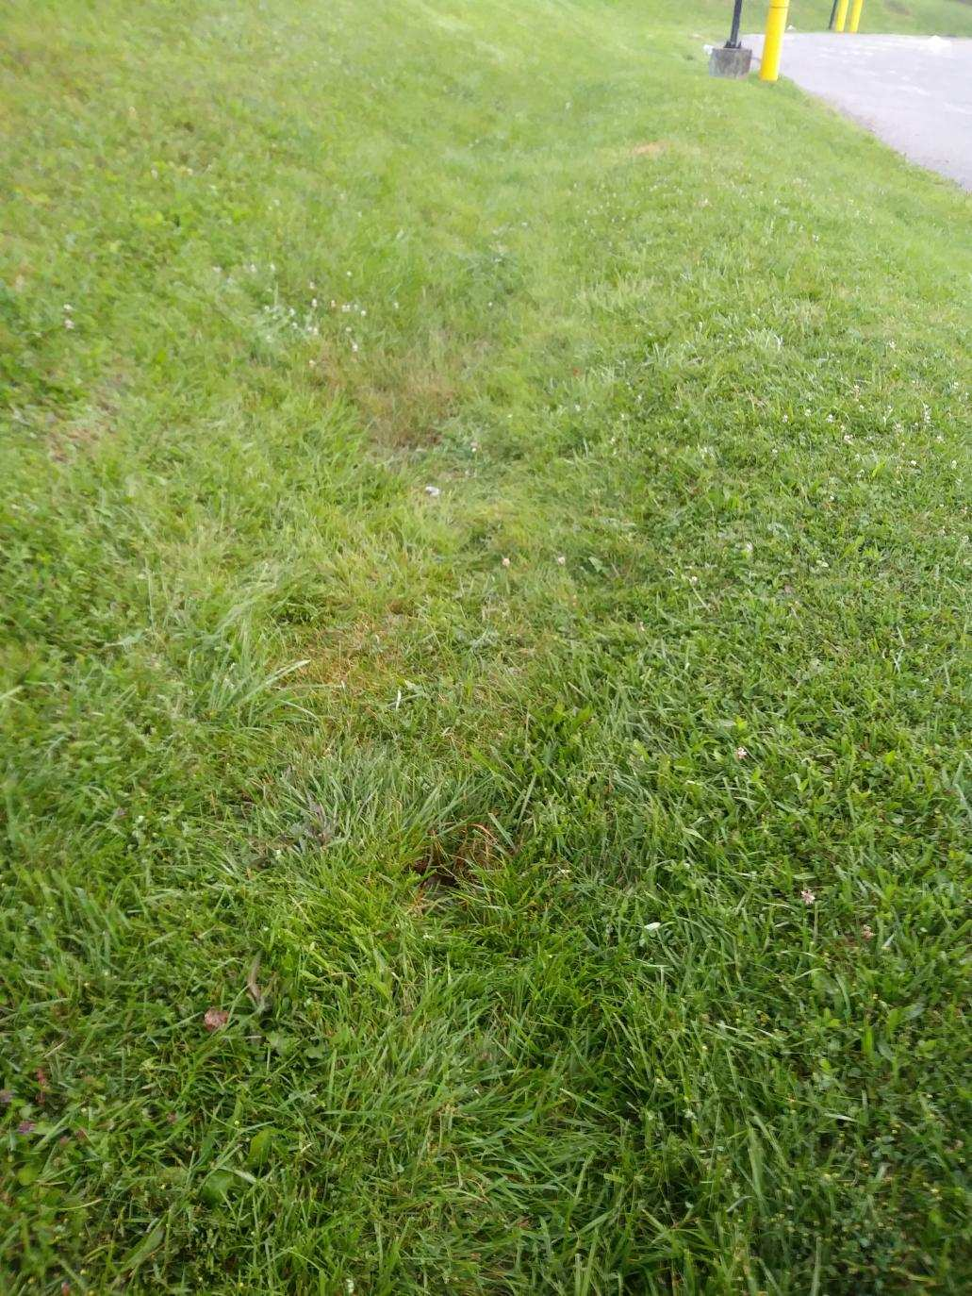
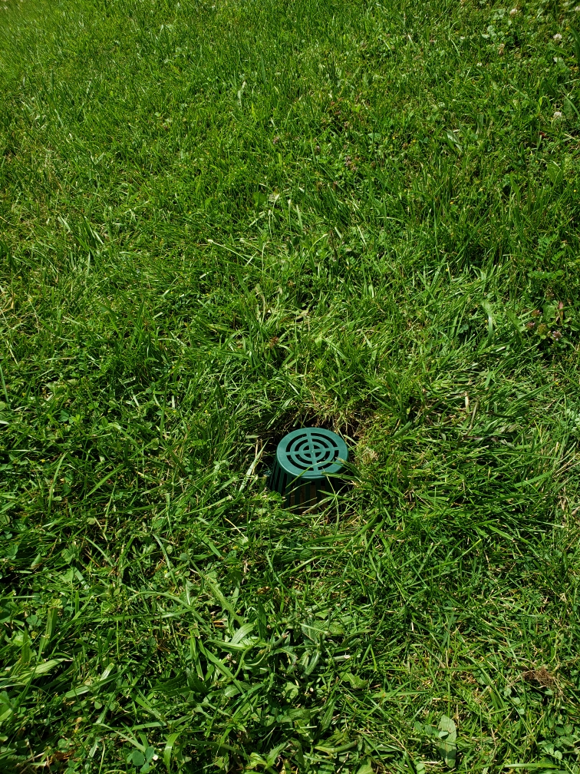
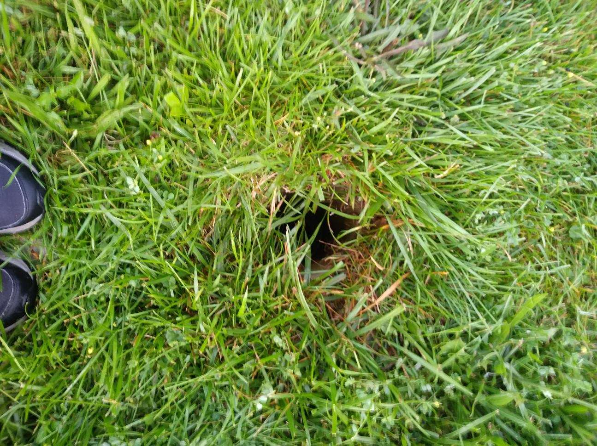
FM customer Incident:
FM 727 on 06/29/2019 – Customer walking dog in grass area and tripped on an open drain pipe and fell resulting in possible injuries. Customer declined an ambulance.

Slide 11
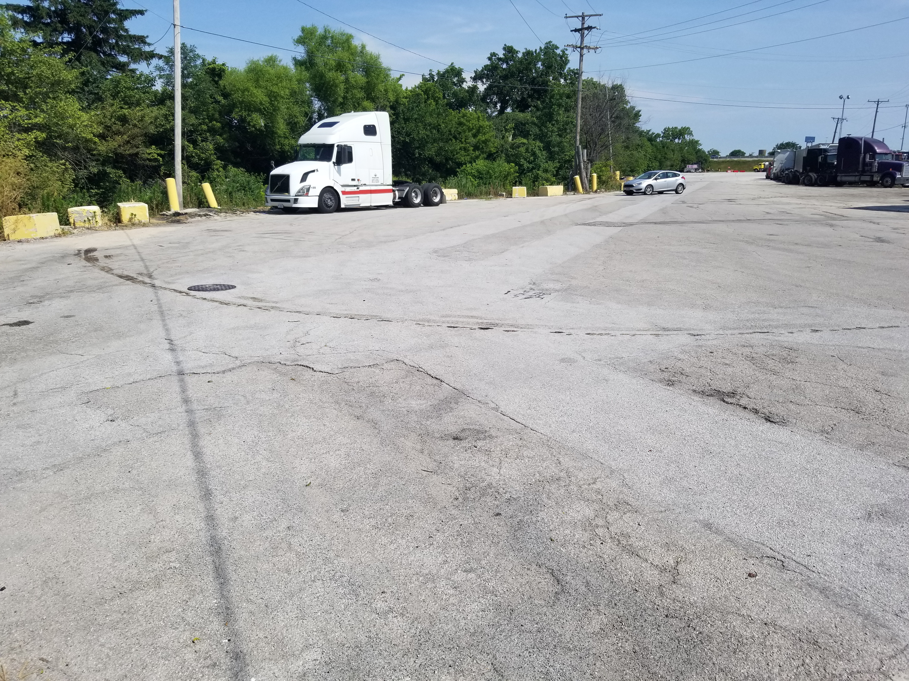
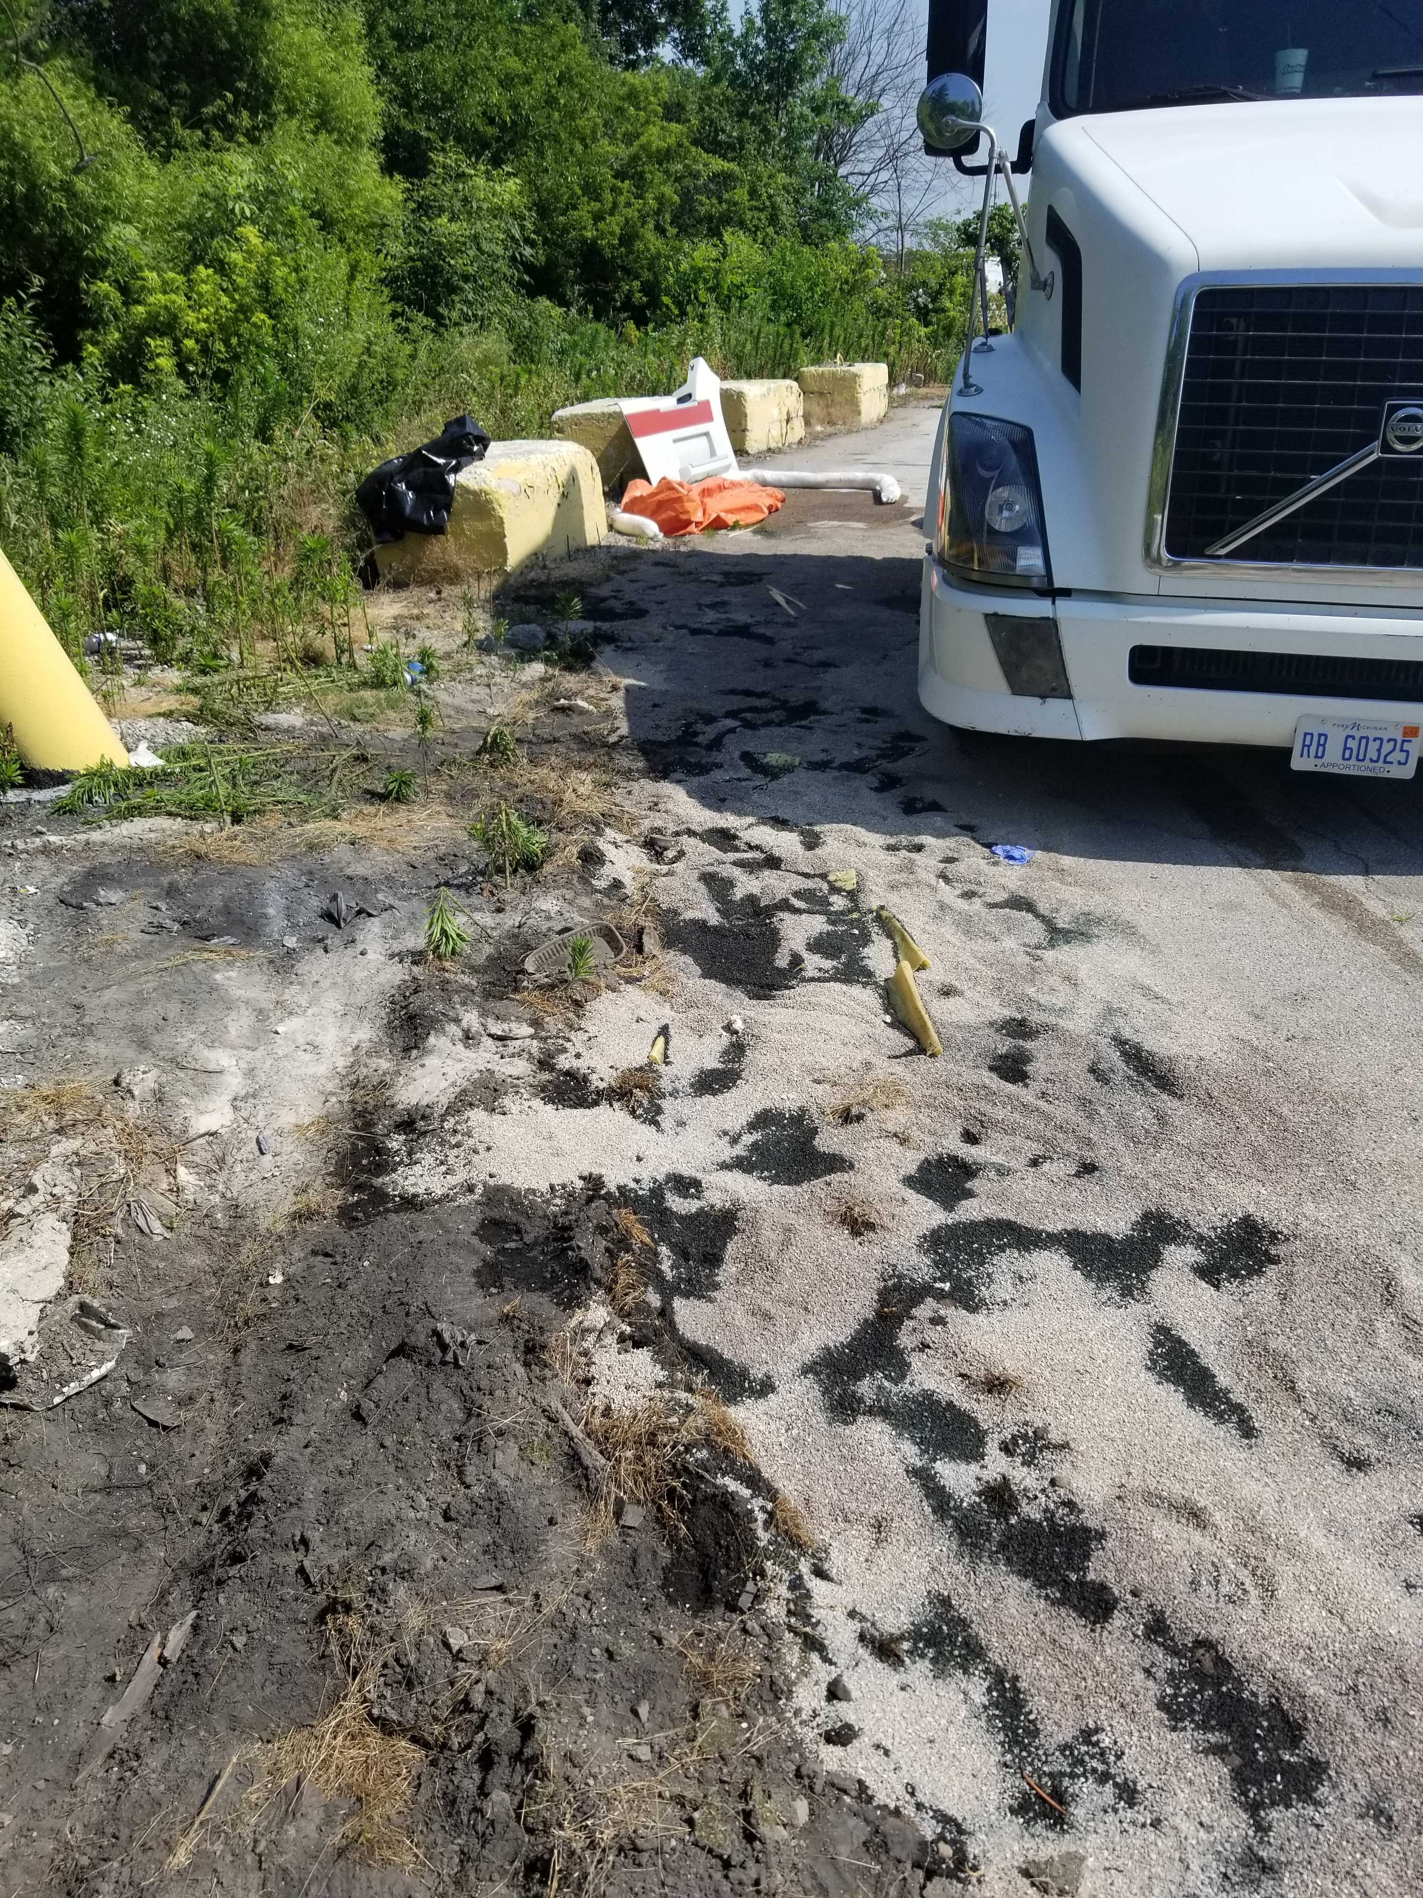
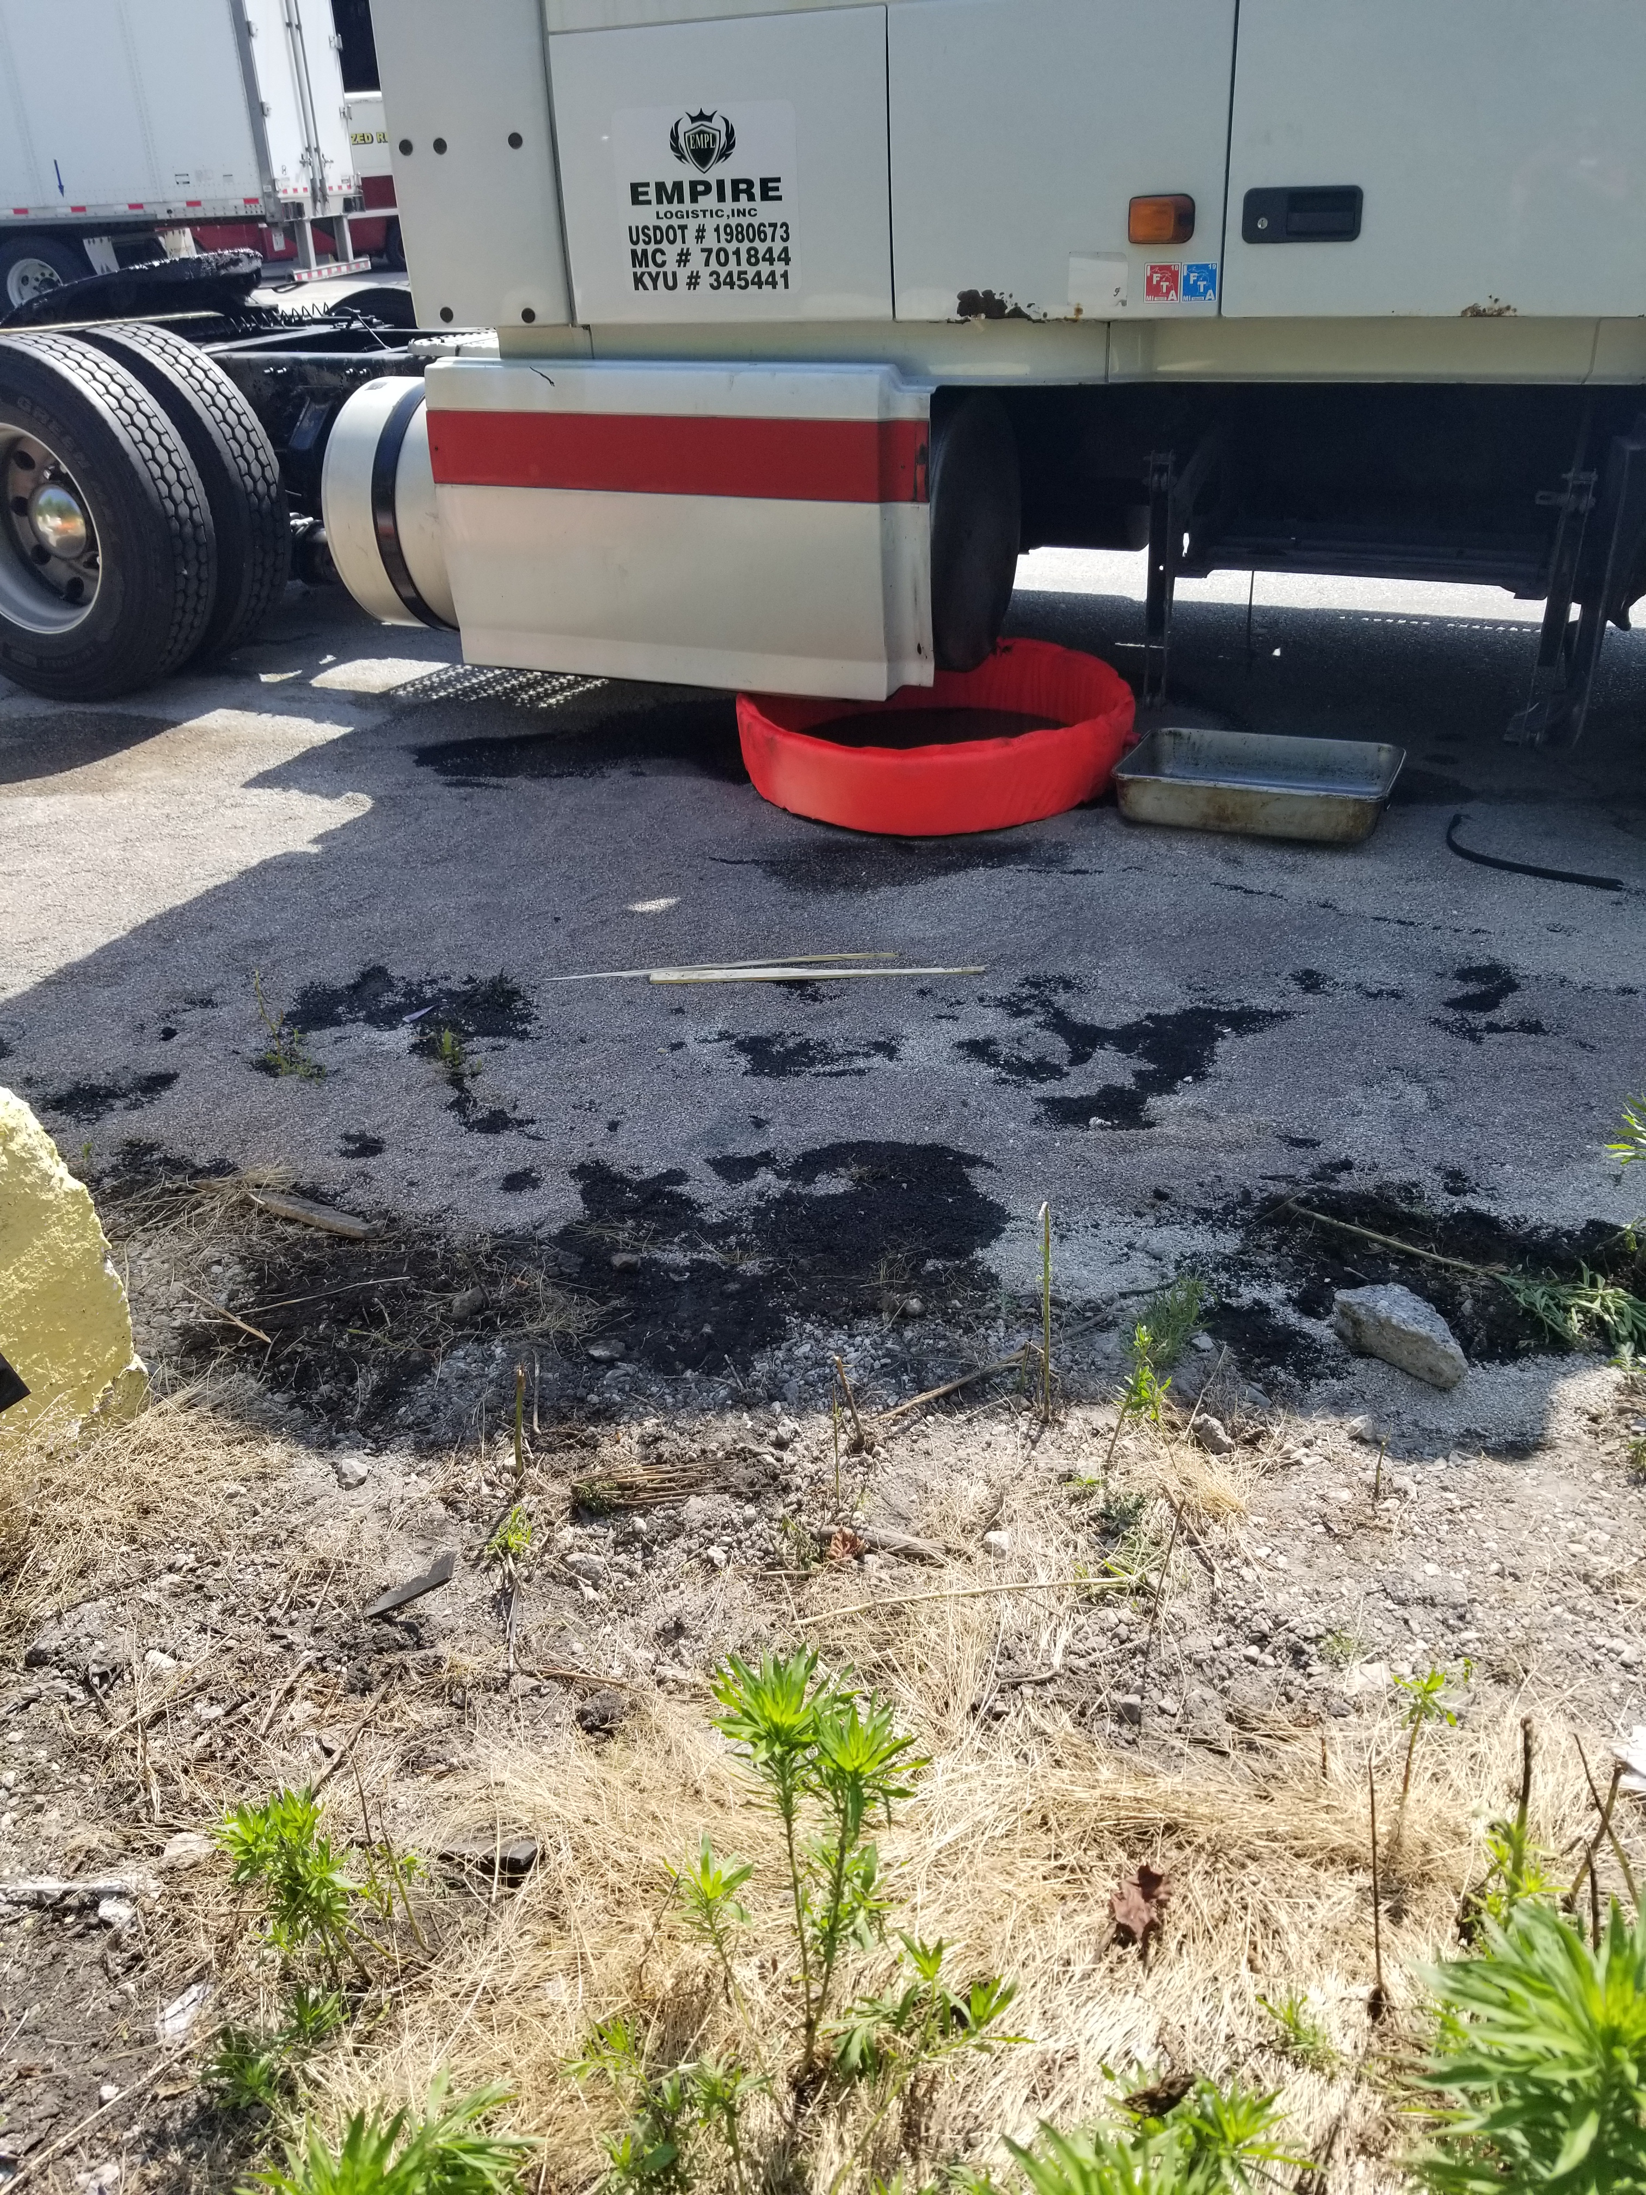
FM 641 diesel spill:
On 07/01/2019 semi struck debris on roadway and pulled onto FM property leaking diesel from the semi saddle tank. Fire Dept. and Ohio EPA responded. FM nor Ports Petroleum was not notified. On 07/02/2019 FM Complex Manager noticed a diesel spill on the property from his daily property inspection. Environmental Remediation Company responded to complete cleanup. No impact to nearby waterway. On 07/10 final cleanup completed.

Slide 12
FM customer Incidents:
FM 767 on 07/14/2019 – Customer not breathing outside by Subway entrance door. Ambulance responded and transported customer to hospital.

Slide 13
Date Range: Jan. 01, 2019 – July 15, 2019 Company Total Incidents: 74 FuelMart & Subway Total Incidents: 50 FuelMart & Subway employee injuries Reported: 11 FuelMart Property Damage and/or Vehicle Incidents: 14 FuelMart Customer Spills: 9 (6 at fuel pumps) FuelMart & Subway Customer injuries reported: 12 Other Incidents: 4

Slide 14
Safety Topic Road Rage

Slide 15
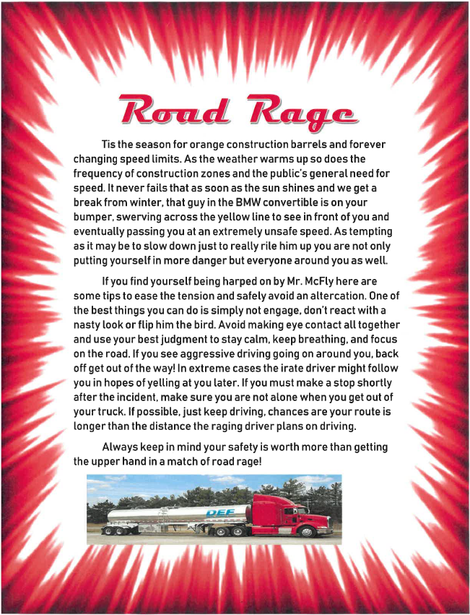

Slide 16
Open Floor Safety Questions / Concerns
Next Safety Committee Meeting is Wednesday, August 21, 2019 at 2:00 PM Eastern

